Slide 1

Slide 1
Which is the best neighborhood for a warehouse for groceries in Scarborough?
IBM Data Science Capstone Project
Eduardo Andre Cuya Nizama
2018

Slide 2
Context
This report is the final project from the IBM Data Science Specialization. The goal of this project is to use the tools and skills acquired through the different courses to develop and idea to leverage the Foursquare location data to explore or compare neighborhoods or cities of our choice in order to come up with a problem that you can be solved using the Foursquare location data

Slide 3
Business Problem
QB is an international company focused on providing consulting services to people who intends to move their business to another city. QB is well-known to always use the top trend tecnologies like machine learning, Blockchain and quantum computing in order to bring better solutions for their clients.
Recently, Michael Rain has asked for QB services. Michael Rain wants to move his warehouse for groceries from Central Toronto (Roselawn) to a neighbourhood in Scarborough. He want to keep their lifestyle and also have the most near groceries as posible to improve the quality of his warehouse.

Slide 4
Data
Neighbourhood information: https://en.wikipedia.org/wiki/List_of_postal_codes_of_Canada:_M
Geo locational information about the neighbourhoods in Scarborough
Foursquare information on venue categories, top tips, location data, ratings, etc.

Slide 5
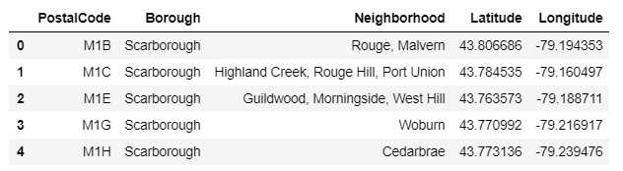
Methodology
Import data from week 3

Slide 6
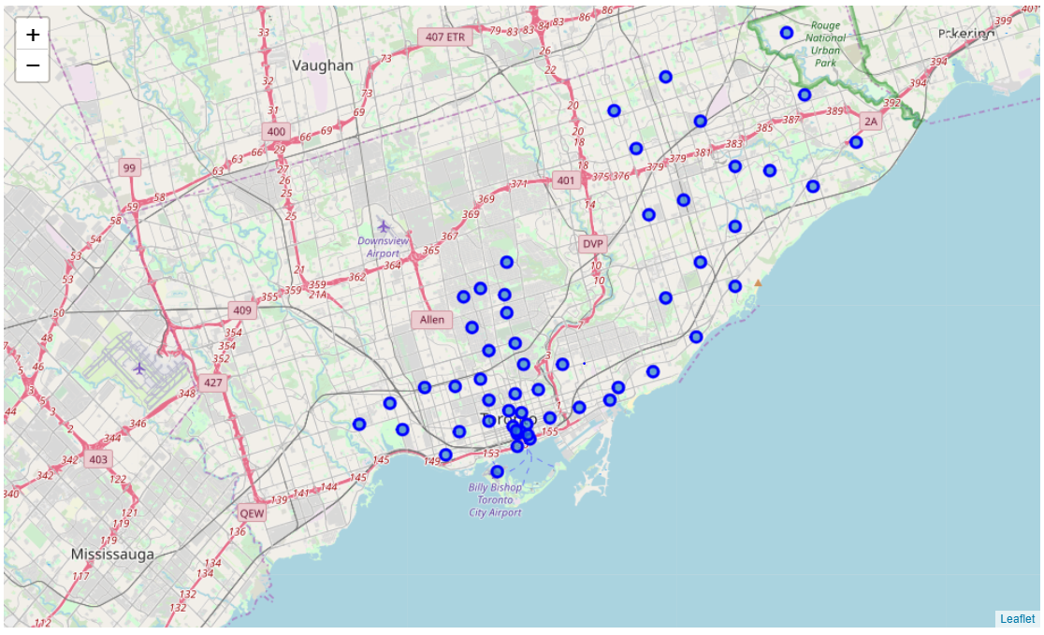
Filter data by borough (Downtown Toronto, East Toronto, West Toronto, Central Toronto, Scarborough)

Slide 7
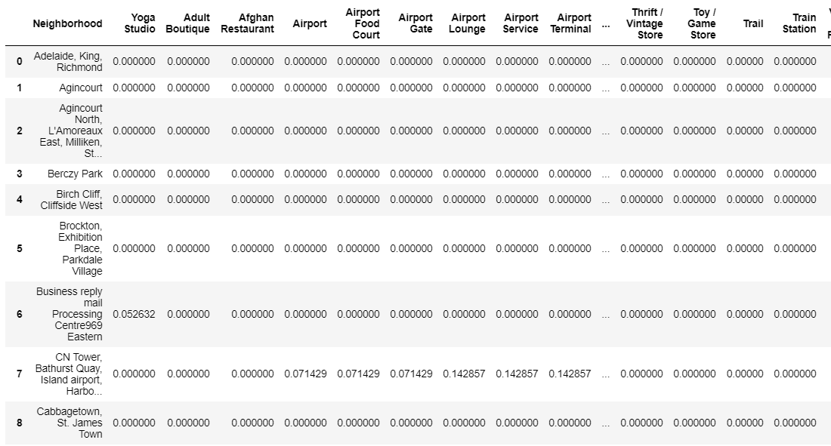
Get venues from FourSquare API

Slide 8
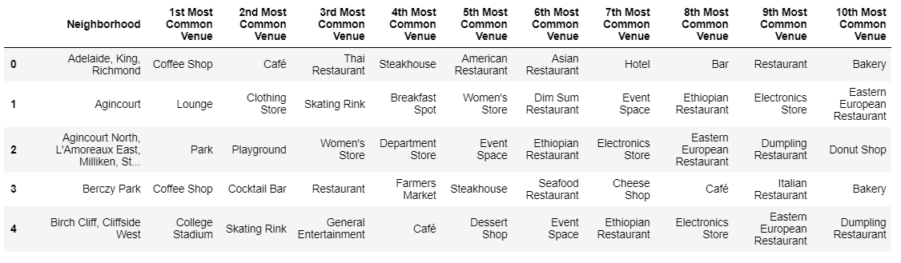
Extract the top 10 venues in each neighborhood

Slide 9
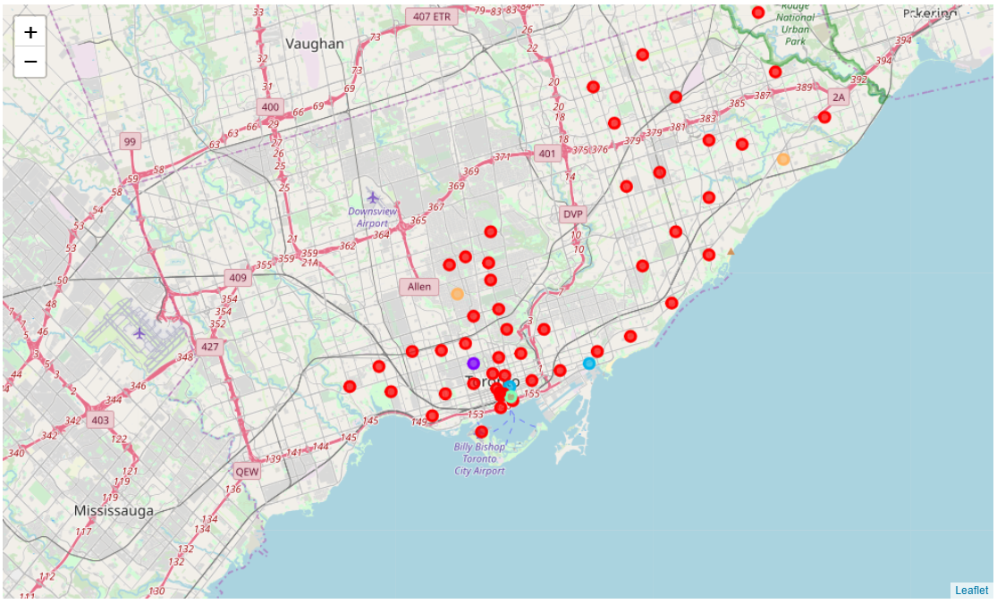
K-mean Cluster to segment all 55 neighborhoods into 5 clusters

Slide 10
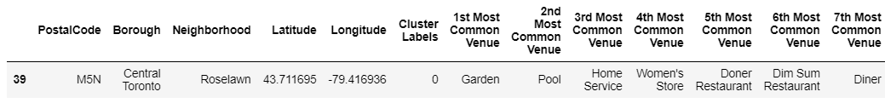
The clients wants to move from Roselawn. According to our clustering, Roselawn is part of cluster 0

Slide 11
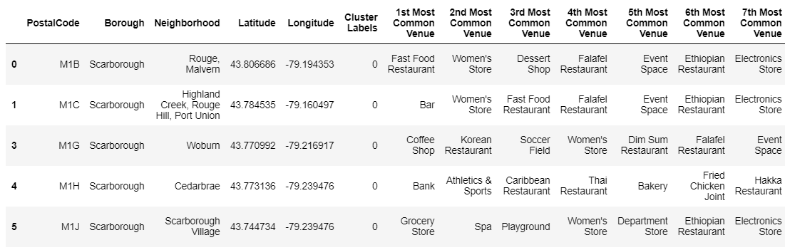
We have 11 candidates whose borough is Scarborough and are part of Cluster 0

Slide 12
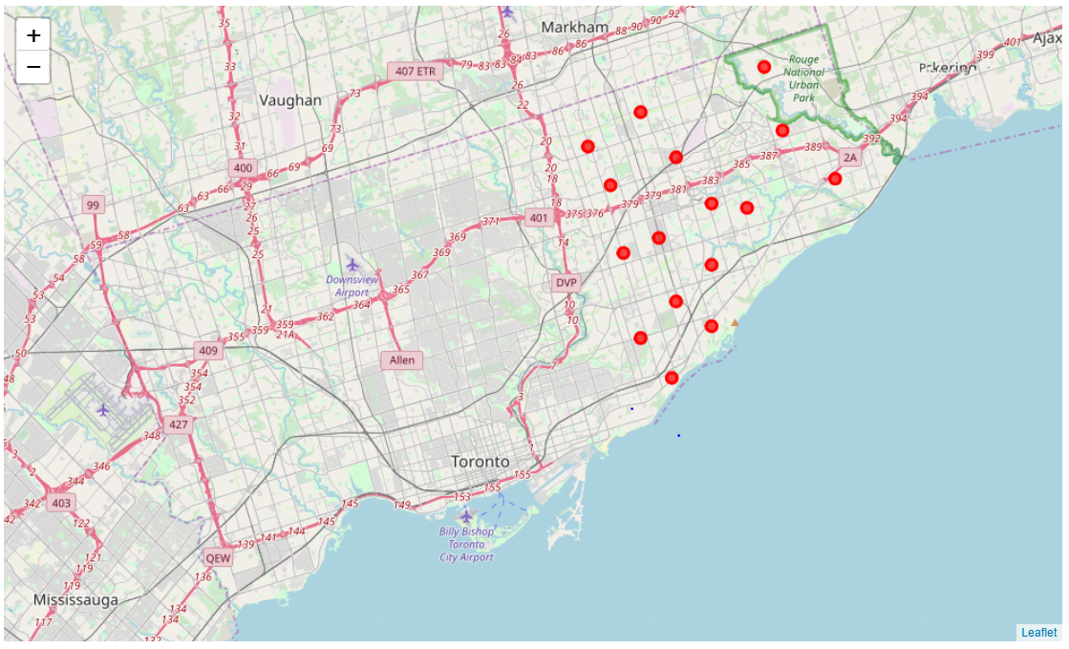

Slide 13
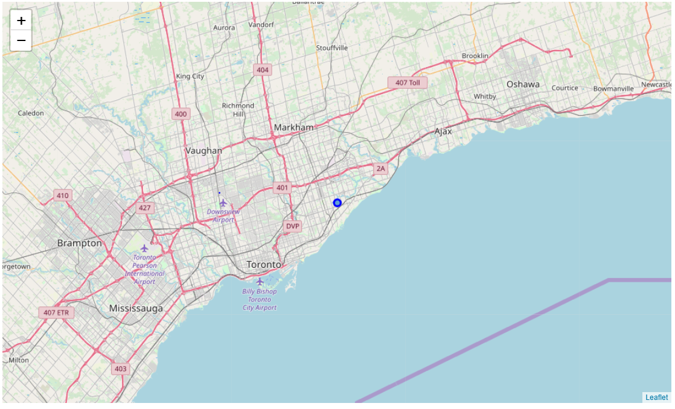
However, one of the most important requirements, was the need of groceries around the neighborhood chosen to maintain the quality of the grocery warehouse. The only candidate who satisfies the 3 requirements was candidate 5 (Scarborough Village).

Slide 14
Results
By exploring the requirement of the clients, we only find one neighborhood (Scarborough Village) that match with this requirement (similar lifestyle, Scarborough, groceries store near)
Discussion
The result is somehow limited for the assumptions we have made. First, being in a cluster does not mean having a similar lifestyle at all with the other neighborhoods in the clusters. The clusters were made by using just the top 10 venues, so we do not analyze completely the neighborhoods with more venues but with less frequency. Furthermore, we get the top 10 venues in a radius of 500, so we should need to analyze if the change of the parameter radius has an impact on the results

Slide 15
Conclusion
According to our analysis, the best neighborhood is Scarborough Village. However, we must take into account the assumptions we have made that may have an impact on the results

Slide 16

Slide 11
THANK YOU

